Slide 1

Sync+ 2.0
CDX706H–Desay_EESE&CVPP parts
China EESE&CVPP
Updated on 2022-08-07
Desired Outcome
Awareness
Decision
Escalation Help
Think
Point of view
Plan to Implement
Implement

Slide 2
{R06 PRO.HF1} Software overall status {yellow}
Software key info
  Refer SWAD for the details:
    MCU version:20220725_498_PRO(CDX706 R06)
    SoC version:20220723_0746_FF27_R06.PRO.HF1_User
    Verification scope and method:
    {Full verification} executed with pass rate 97.90%, 0P1 and 29P2 issues found and not fixed. Refer test report for detail.
Highlights listed below:
    Release Note – refer slide 3
    Open P2 issue list with risk evaluation – refer slide 4
    Performance Status– refer slide 5-7
    OTA Status– refer slide 8
Notes:
Add P1 weekly burn down chart

Slide 3
{R06 PRO.HF3} 性能修改点
序号 | ID | 描述 | 验证结果 | Comment
1 |  | Baidu APK更新
Notes:
Add P1 weekly burn down chart

Slide 4
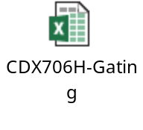
{R06 PRO.HF3} Open P2 issue list with risk evaluation
计数项:Status | 修复版本
Gating | FF27_R07.ENG1 | FF27_R07.ENG2 | FF27_R07.PRO | 总计
Analysis |  |  | 17 | 17
DEFINED |  |  | 1 | 1
Developing | 1 |  | 2 | 3
New |  |  | 1 | 1
Verification |  | 2 | 5 | 7
总计 | 1 | 2 | 26 | 29
Notes:
Add P1 weekly burn down chart

Slide 5
{R06 PRO.HF3} 性能测试状态
1.该版本的性能优化：
1）706H radio在R06版本上主要做了一些布局层级优化、异步加载布局和优化冗余逻辑；
2）看FM温启动视频，从手指开始抬起，到界面完成显示稳定是有600ms时间，去掉 app默认的200ms渐变动画。
Notes:
Add P1 weekly burn down chart

Slide 6
{R06 PRO HF3} 性能测试状态
序号 | 影响因素 | 权重 | SPEC | Reference | R05 | R05.HF1 | R06 | 偏差 | 分析
1 | Power on第一帧动画播放 | 1 | 5s | 7s | 8.49 | 8.19 | 8.81 | 7.60%
2 | Power on Launcher界面可见 | 1 | 12s | 15.8 | 20.12 | 19.75 | 19.72 | -0.13%
3 | Power on优先蓝牙重连完成 | 1 | 12s | 14.2 | 10.60 | 10.74 | 10.26 | -4.45%
4 | Power on车机网络时间同步完成 | 0.5 |  | 9.2 | NA | 18.30 | 17.63 | -3.64%
5 | Power on开机到Fast RVC显示 |  |  |  | 6.96 | 7.45 | 6.86 | -7.93%
6 | Power on Launcher启动后Fast RVC显示 | 2 | 2s | 6s | 1.98 | 0.88 | 1.13 | 28.56%
7 | Power on优先设备BT音源恢复 | 1 |  | 18.2 | 12.24 | 13.79 | 8.60 | -37.62%
8 | Power on车辆设置界面打开 | 0.5 | 3.5s | 7.2 | 4.80 | 3.24 | 3.37 | 3.80%
9 | Power on空调设置界面打开/快捷菜单上点击空调按钮可用 | 0.5 |  | 7.2 | 4.68 | 4.18 | 3.00 | -28.15%
10 | Power on SDM可用 | 0.5 |  | 7.2 | 5.98 | 5.44 | 5.03 | -7.56%
11 | SDM切换成功 | 0.5 |  | 7 | 4.43 | 4.53 | 4.61 | 1.85%
12 | Launcher显示到进入稳定运行阶段经过的时间 | 2 |  |  | 59.04 | 40.58 | 43.03 | 6.04%
13 | 系统稳定状态下Setting首次启动 | 0.5 |  | 1.5s | 1.35 | 1.27 | 1.03 | -18.76%
14 | 系统稳定状态下蓝牙音乐首次启动 | 1 |  | 1.5s | 2.56 | 3.28 | 1.98 | -39.70%
15 | 系统稳定状态下FM首次启动 | 1 |  | 1.5s | 4.88 | 2.85 | 1.28 | -55.02%
16 | Setting热启动 | 1 |  | 200ms | 0.66 | 0.55 | 0.60 | 8.88%
17 | 蓝牙音乐热启动 | 1 |  | 200ms | 0.66 | 0.55 | 0.94 | 70.83% | 上个版本使用的测试手机不支持专辑图片和播放列表，这个版本多了专辑图片和播放列表，所以热启动加载时间不一样（加上渐变动画200ms）
18 | FM热启动 | 1 |  | 200ms | 1.27 | 1.32 | 0.61 | -54.14%
19 | air conditioner热启动时间 | 0.5 |  | 200ms | 0.23 | 0.25 | 0.21 | -15.56%
20 | 蓝牙电话冷启动时间 | 0.5 |  | 12s | 11.52 | 11.51 | 10.37 | -9.92%
21 | 蓝牙电话热启动时间 | 0.5 |  | 200ms | 0.21 | 0.19 | 0.27 | 41.45%
22 | 投屏冷启动时间 | 0.5 |  | 2s | 2.91 | 1.70 | 1.49 | -12.22%
23 | 精简屏幕冷启动时间 | 0.5 |  | 2s | 1.17 | 1.38 | 1.40 | 1.98%
24 | 精简屏幕热启动时间 | 0.5 |  | 200ms | 1.07 | 1.10 | 0.77 | -30.26%
Notes:
Add P1 weekly burn down chart

Slide 7
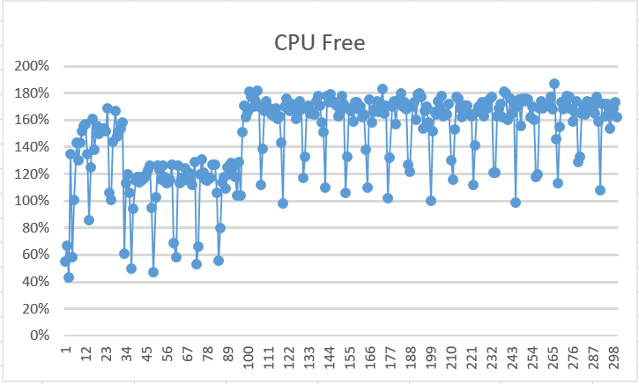
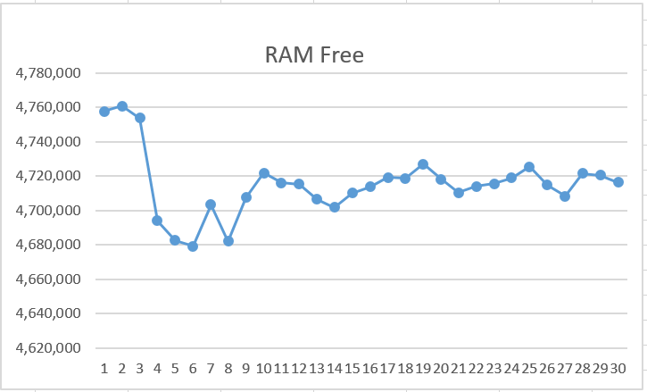
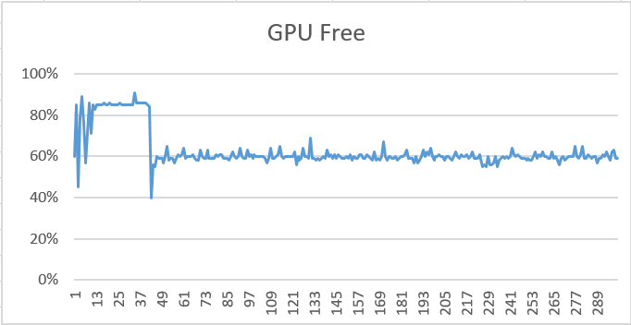
{R06 PRO HF3} 性能状态
序号 | 影响因素 | 权重 | R05 | R05.HF1 | R06 | 偏差
1 | 8小时Monkey测试-设置 （com.desay.setting） | 0.5 |  |  | 0 | Pass
2 | 8小时Monkey测试-蓝牙音乐（com.desaysv.mediaplayer） | 0.5 |  |  | 0 | Pass
3 | 8小时Monkey测试-蓝牙电话 （com.desay_svautomotive.bluetoothtel） | 0.5 |  |  | 0 | Pass
4 | 8小时Monkey测试（其他所属应用） | 0.5 |  |  | 0 | Pass
5 | 24小时Monkey测试中的CPU Free | 1 | 12% | 13% | 61% | Pass
6 | 24小时Monkey测试中的RAM Free | 1 | 1431422K | 1431422K | 2329897K | Pass
7 | 24小时Monkey测试中的GPU Free | 1 | 78% | 76% | 78% | Pass
8 | 24小时Monkey中的ANR次数 | 1 |  |  | 0 | Pass
9 | 24小时Monkey中的Crash次数 | 1 |  |  | 0 | Pass
10 | 24小时Monkey中内存泄露进程数 | 1 |  |  | 0 | Pass
CPU Free
RAM Free
GPU Free
Notes:
Add P1 weekly burn down chart

Slide 8
{R06 PRO.HF3} OTA测试状态
Title: | Verification Test Report For OTA
Function Name | Total Test Case | Passed Test Case | Failed Test Case | Percentage of Test Completion: | Test Cases Pass Percentage:
TC_SOC_OTA | 86 | 78 | 0 | 90.70% | 100.00%
TC_MCU_OTA | 74 | 74 | 0 | 100.00% | 100.00%
TC_MCU_USB | 66 | 65 | 0 | 98.48% | 100.00%
TC_SOC_USB | 66 | 66 | 0 | 100.00% | 100.00%
Total | 292 | 283 | 0 | 96.92% | 100.00%
Test Summary Description
pass
Notes:
Add P1 weekly burn down chart

